Slide 1

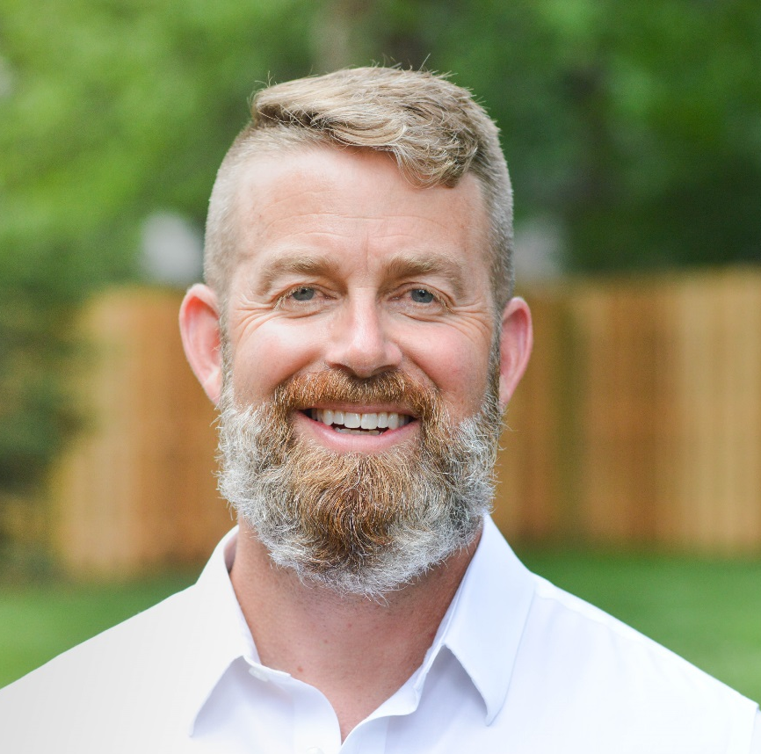

Horsesmouth – Advisor Radio
How to Grow Your Business
as an entrepreneurial Advisor.
Ellen Rogin, Best Selling Author and Patrick Tucker, author, speaker, 7-figure wealth manager & coach for Advisors sit down to talk about finding your niche, mindset traps to avoid, and what’s working now to grow your business. Listen in.

Slide 2
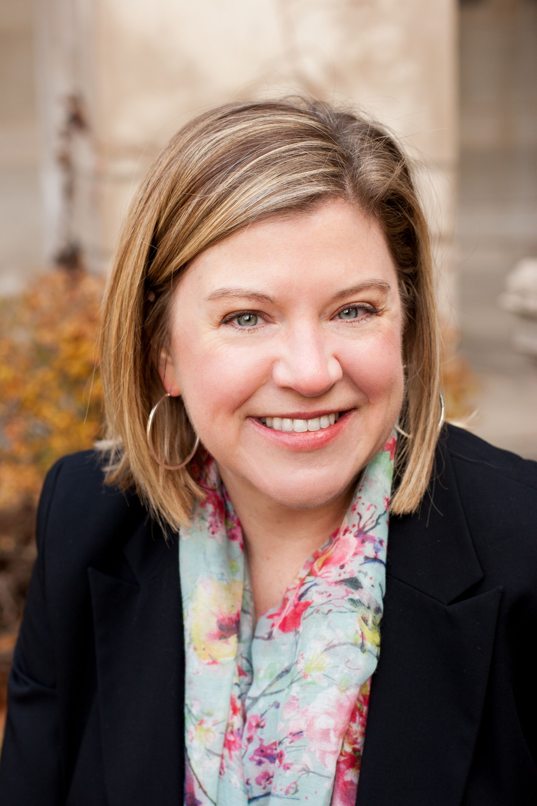
Horsesmouth – Advisor Radio
How to Wow Your Clients
Ellen Rogin, Best Selling Author and Professional Speaker, and Jeannie Walters, Customer Experience Expert discuss being deliberate about the experience your clients have. Learn how to ensure they never second guess hiring you.
Notes:
https://soundcloud.com/horsesmouth/how-to-wow-your-clients-by-exceeding-their-expectations

Slide 3
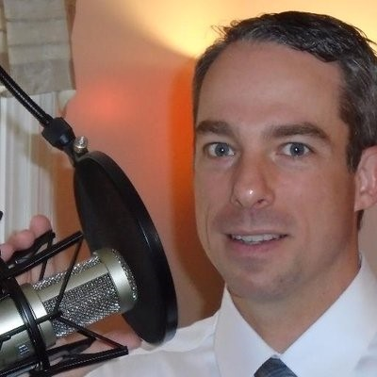
Horsesmouth – Advisor Radio
Being A Resiliant Advisor
Ellen Rogin, Best Selling Author and Professional Speaker, and Jay Coulter, Customer Practice Management Strategist discuss how to reduce stress and grow your business. Listen in.

Slide 4
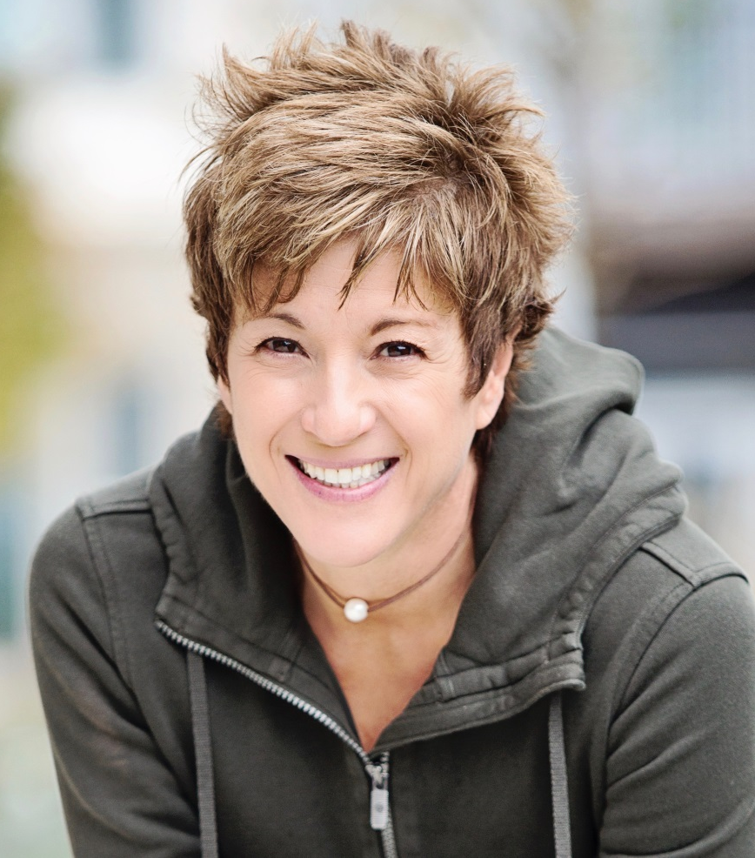
Horsesmouth – Advisor Radio
How to Shift to a State of Flow
Ellen Rogin, Prosperity Expert, Best Selling Author and Speaker, and Cara Bradley, Authority on mind body training talk about on to boost performance. Listen in!

Slide 5
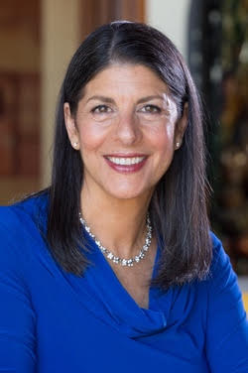
Horsesmouth – Advisor Radio
Use Relationship Capital
to build Your Business
Ellen Rogin, Best Selling Author and Professional Speaker,
talks to Debra Poneman, Mentor, Best Selling Author and Renowned Speaker about how you can leverage relationship capital to grow your business. Listen in.
Notes:
https://soundcloud.com/horsesmouth/why-your-teams-culture-is-the-key-to-unlocking-high-performance

Slide 6
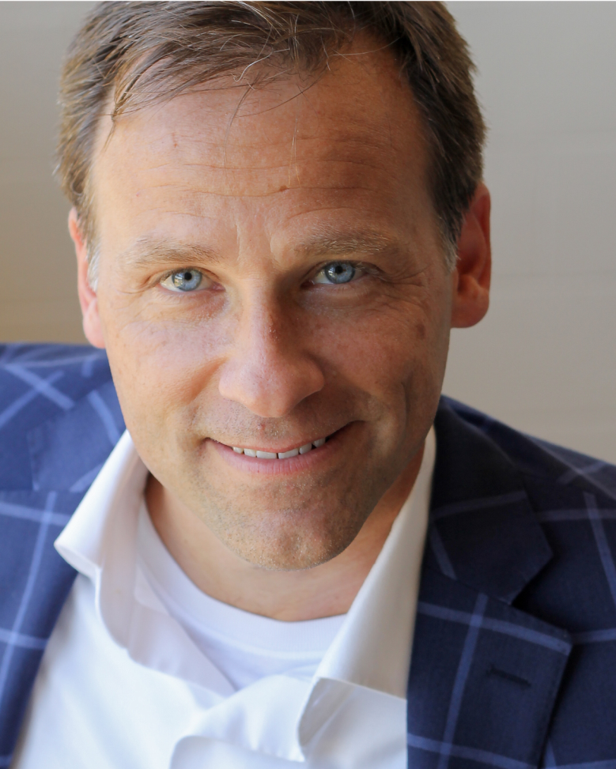
Horsesmouth – Advisor Radio
Why Your Team’s Culture is the Key to Unlocking Business Performance
Ellen Rogin, Best Selling Author and Professional Speaker,
talks to Greg Hawks, Corporate Culture Specialist. Your team’s culture is the deciding factor in how motivated your team is. Improving it is a game changer. Listen in.
Notes:
https://soundcloud.com/horsesmouth/why-your-teams-culture-is-the-key-to-unlocking-high-performance

